Slide 1

Advanced x86: BIOS and System Management Mode Internals SMRAM (System Management RAM)
Xeno Kovah && Corey Kallenberg
LegbaCore, LLC

Slide 2
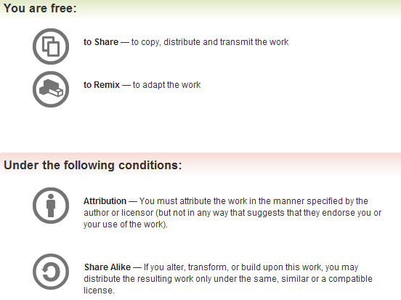
All materials are licensed under a Creative Commons “Share Alike” license.
http://creativecommons.org/licenses/by-sa/3.0/
Attribution condition: You must indicate that derivative work
"Is derived from John Butterworth & Xeno Kovah’s ’Advanced Intel x86: BIOS and SMM’ class posted at http://opensecuritytraining.info/IntroBIOS.html”
Notes:
Attribution condition: You must indicate that derivative work
"Is derived from John Butterworth & Xeno Kovah’s ’Advanced Intel x86: BIOS and SMM’ class posted at http://opensecuritytraining.info/IntroBIOS.html”

Slide 3
Prelude
So we have talked about what causes the system to enter SMM
And we’ve (sort of) even “seen” it happen
As best as possible
But we haven’t talked about SMM’s address space yet …

Slide 4
SMRAM
SMRAM is the address space where the processor switches to upon entering SMM
This address space contains the SMI handler code and data
The processor’s pre-SMI register context is saved at a pre-defined location in SMRAM (fixed offset from SMBASE)
SMBASE is the base address of SMRAM and is located in a reserved portion of main RAM
Thus access control mechanisms must be based in the memory controller (MCH or CPU)

Slide 5
Address Space Layout
First off, lets define the terms SMBASE and SMRAM
SMRAM refers to the entire range (or ranges) where the SMI handler code and data is located
SMBASE is a private CPU-internal register that holds the address denoting the base address of SMRAM for a processor (or core)
Each core will have its own SMBASE
The state save area(s) and entry point(s) are fixed offsets from SMBASE
SMBASE is also found as a field stored in the state save area within SMRAM
The stored value is always at the same offset from SMBASE (FEF8h)
A 32-bit value containing the physical address of SMRAM (SMBASE)
Even in x64 architecture
Therefore SMRAM is relocatable by changing the saved value of SMBASE, stored in the SMRAM save state area upon SMI
We’ll talk about where in physical memory SMBASE/SMRAM is likely to be located in a bit

Slide 6
SMBASE + SMRAM Size
.
.
.
.
SMBASE + 8000h + 7FFFh
Start of State Save Area
SMBASE + 8000h + 7E00h (32 bit)
SMBASE + 8000h + 7C00h (64 bit)
SMI Handler (code) Entry Point
SMBASE + 8000h
SMBASE
Default SMBASE on startup is 30000h, but can be relocated
SMI Handler Executable code entry point is always at SMBASE + 8000h
CPU always begins executing at SMBASE + 8000h
Multi-core systems will typically have their SMBASE offset by N bytes from each other. For example:
Core 0 defines SMBASE as A_0000h, will enter SMI handler at A_8000h
Core 1 defines SMBASE as A_1000h, will enter SMI handler at A_9000h

Slide 7
SMBASE + SMRAM Size
.
.
.
.
SMBASE + 8000h + 7FFFh
Start of State Save Area
SMBASE + 8000h + 7E00h (32 bit)
SMBASE + 8000h + 7C00h (64 bit)
SMI Handler (code) Entry Point
SMBASE + 8000h
SMBASE
State save address starts at SMBASE + 8000h + 7FFFh
SMBASE + FFFFh
For 32-bit CPU’s, the state-save area is 200h bytes
State save area extends down to SMBASE + 8000h + 7E00h
SMBASE + FE00h

Slide 8
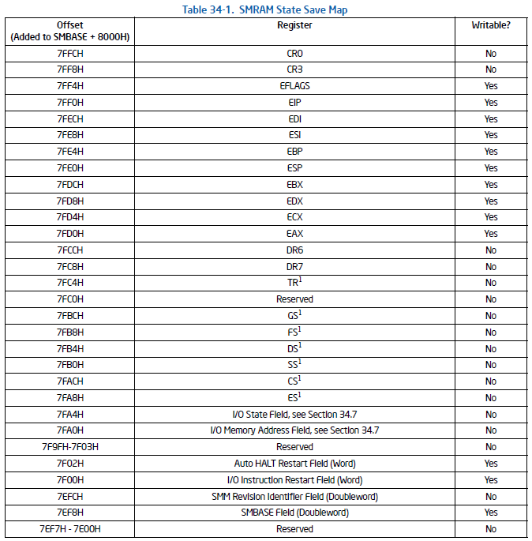
32-Bit
From Intel Vol. 3. Ch. "System Management Mode"

Slide 9
SMBASE + SMRAM Size
.
.
.
.
SMBASE + 8000h + 7FFFh
Start of State Save Area
SMBASE + 8000h + 7E00h (32 bit)
SMBASE + 8000h + 7C00h (64 bit)
SMI Handler (code) Entry Point
SMBASE + 8000h
SMBASE
State save address starts at SMBASE + 8000h + 7FFFh
SMBASE + FFFFh
For 64-bit CPU’s, the state-save area is 400h bytes
The state-save extends down to SMBASE + 8000h + 7C00h
SMBASE + FC00h

Slide 10
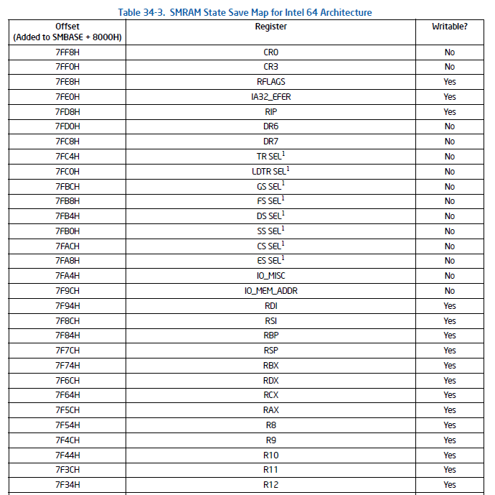
64-Bit
From Intel Vol. 3. Ch. "System Management Mode"

Slide 11
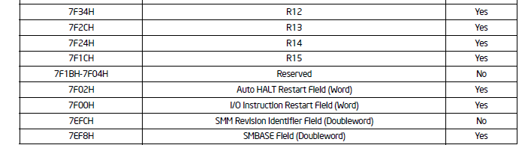
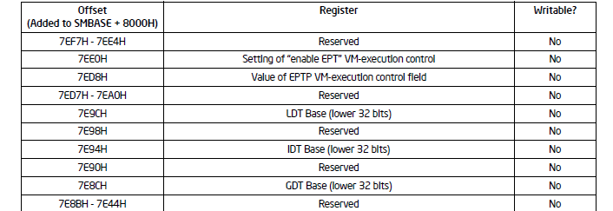
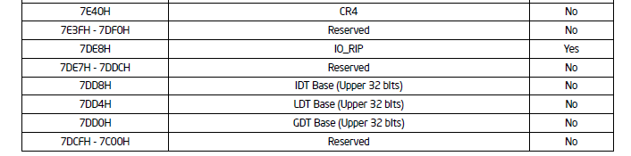
64-Bit
SMBASE field for both 64-bit and 32-bit architectures is always located at the same offset from SMBASE (FEF8h)

Slide 12
SMBASE + SMRAM Size
.
.
.
.
SMBASE + 8000h + 7FFFh
Start of State Save Area
SMBASE + 8000h + 7E00h (32 bit)
SMBASE + 8000h + 7C00h (64 bit)
SMI Handler Entry Point
SMBASE + 8000h
SMBASE
The remaining area is free for use as SMI handler code and data
Total size of SMRAM region is defined by the BIOS when it configures SMM

Slide 13
Core 1 SMBASE + FFFFh
D001_0FFFh
Core 1 State Save Area
D001_0E00h
Core 0 SMBASE + FFFFh
D000_FFFFh
Core 0 State Save Area
D000_FE00h
Core 1 SMI Entry Point
Core 1 SMBASE + 8000h
D000_9000h
Core 0 SMI Entry Point
Core 0 SMBASE + 8000h
D000_0000h
Core 1 SMBASE
D000_1000h
Core 0 SMBASE
D000_0000h
Each core will have its own SMBASE address offset from the other core(s) SMBASE addresses
Like 1000h bytes per the above 32-bit example
Another core could define its SMBASE in a completely separate memory address
In this diagram I show them sharing the same SMRAM memory range
In practice, some cores will simply execute a dead loop

Slide 14
SMRAM Location
SMRAM can be located anywhere in the 4GB memory address space
SMBASE can be overwritten by the SMI handler
Typically SMRAM is relocated at least once:
On system startup, the first time the system enters SMM, SMBASE is at 0x30000
SMI handler starts executing at 0x38000
There is no reason it needs to stay at that address
Intel defines a few locations for SMRAM
But it really is a flexible system and can be put anywhere
I think these guidelines are provided to make configuration easier for the BIOS developers and to avoid areas where SMRAM may overlap with other regions
This is all part of building that memory map

Slide 15
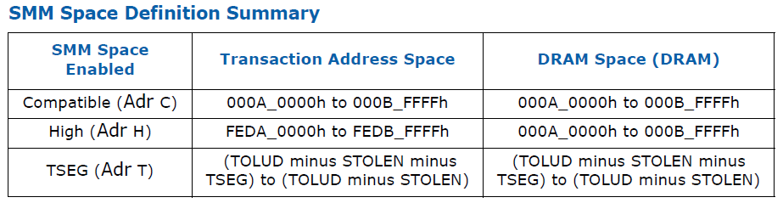
Standard SMRAM Locations
On ICH/MCH chipsets there are 3 standard locations for SMRAM
On PCH chipsets the High Address (HSEG) is no longer supported (so 2 locations)
Technically the base address of SMRAM can be relocated by the SMI handler
But there are reasons these guidelines should be followed and for all practical purposes SMRAM will be in TSEG

Slide 16
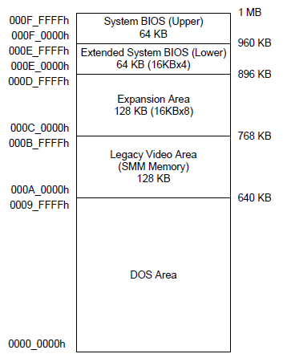
Compatible SMRAM (Legacy Video Area)
Fixed address space
Legacy VGA space (A_0000 - B_FFFFh)
When compatible SMM space is enabled, SMM-mode processor accesses to this range are routed to physical system memory at this address.
Non-SMM-mode processor accesses to this range are considered to be to the video buffer area.
Legacy (DOS) Compatibility Range

Slide 17
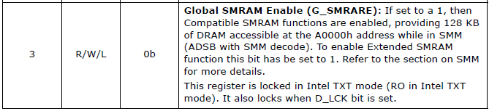
Enabling Compatible SMRAM
This address space is enabled by asserting the G_SMRAME bit
I believe G_SMRARE is a typo in the datasheet
The register (SMRAMC) containing this bit will be located in a different place depending on the architecture
On our E6400 it is located in the DRAM Controller (D0:F0) at offset 9Dh
On a Haswell system, for example, it is also located in the DRAM controller but at offset 88h

Slide 18
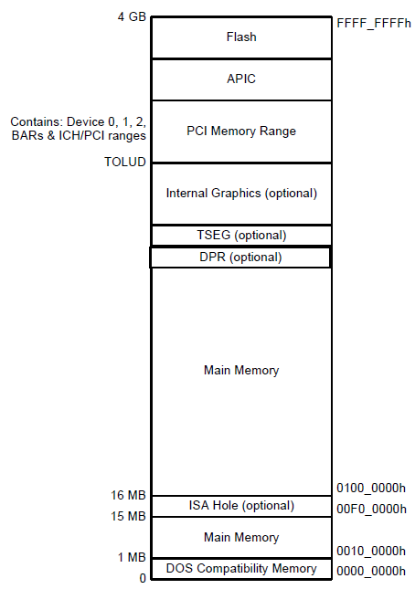
TSEG (Top of Main Memory Segment)
Variable address space
In terms of size and location
Located at:
TOLUD – STOLEN – TSEG_SZ
to TOLUD – STOLEN
STOLEN refers to Graphics Memory Stolen, which is optional and can be zero
New architecture enables more customized location/size of TSEG
STOLEN
* Xeno thinks this is provided by SMRR now
When extended SMRAM space is enabled, processor accesses to the TSEG range when the processor is not in SMM are treated as invalid
TODO: fixme?
Non-processor originated accesses are not allowed to TSEG range.

Slide 19
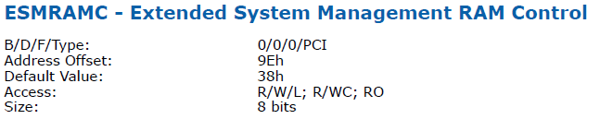
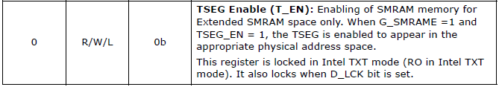
Enabling TSEG
TSEG is enabled differently depending on the architecture
On MCH chipsets, it was defined in the ESMRAMC register
Either 1, 2, or 8MB in size for TSEG (defined in bits 2:1)
On our E6400 it’s in D0:F0, offset 9Eh
Newer systems offer more flexibility in TSEG size and location

Slide 20
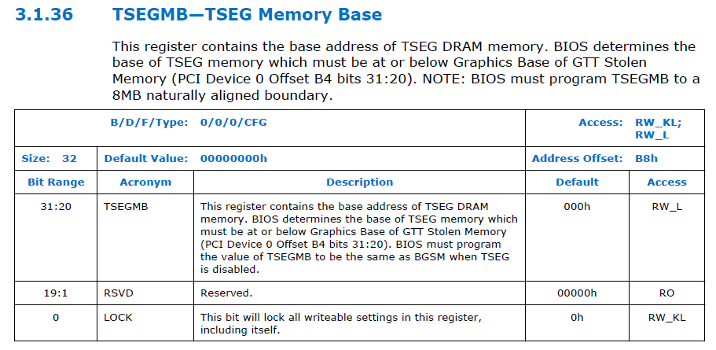
Enabling TSEG on new platforms
On newer systems the size of TSEG is more flexible in its programming
The offset of this register and its method of programming is dependent on the memory controller (which exists either in the MCH or the processor)
Notes:
Note that on newer systems it gets its own lock bit, and is no longer dependent on D_LCK

Slide 21
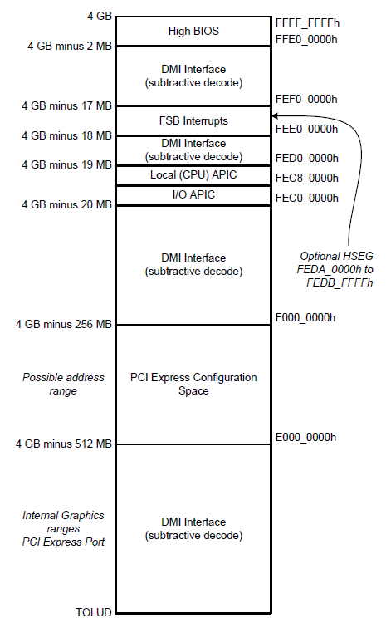
HSEG (High SMM Memory Space)
Fixed address space
FEDA_0000 to FEDB_FFFFh
When enabled (if supported), A_0000h to B_FFFFh are remapped to high memory
Not supported in PCH chipsets
Note: TSEG is located under TOLUD which is located at the bottom of this diagram

Slide 22
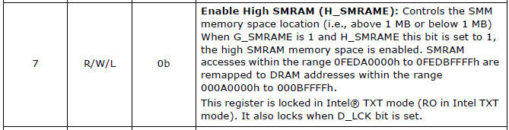
Enabling HSEG
HSEG is enabled when bit 7 of the ESMRAMC bit is set
Not supported on PCH systems and later

Slide 23
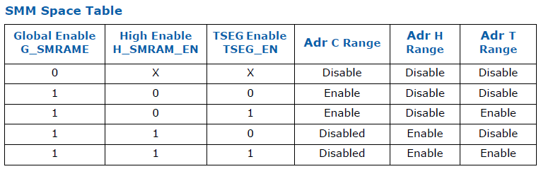
SMRAM Combinations (MCH-based)
Up to two memory locations can be used for SMRAM on a system
There is still only one SMBASE per core
Global Enable means that SMM compatible space is turned on
Disabling the C-range disables all other ranges
So if you’re using TSEG, there is guaranteed to be either the C-range or the H-range also present
I removed H-range discussion from this class for time reasons. It’s pretty straightforward, and you can see the manuals if you’re interested. But you probably mostly all have PCH-based systems so…

Slide 24
SMRAM Combinations (PCH-based)
Up to two memory locations can be used for SMRAM on a system
Which is good since on PCH there is only the Compatible and TSEG ranges; HSEG is no longer supported
As you can see, this means that the Compatible range is always enabled if TSEG is enabled
So the only question is whether or not you use TSEG

Slide 25
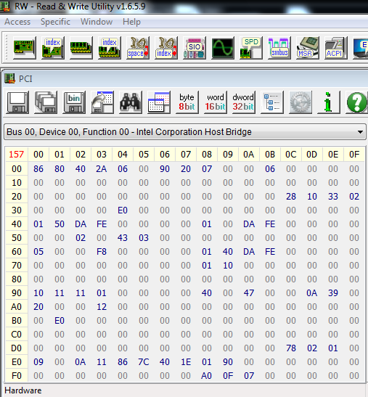
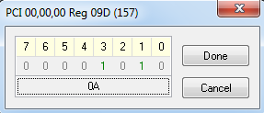
Demo: Locating SMRAM
First let’s see what address ranges are enabled on our system for SMRAM
Open RW-Everything and select PCI devices, device 0, function 0 (the DRAM Controller)
Look at offset 9Dh (SMRAMC register)
See if bit 3 (G_SMRAME) bit is set
Compatible SMRAM at A_0000 to B_FFFFh is set

Slide 26
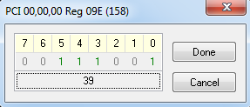
Demo: Locating SMRAM
Let’s now check to see if TSEG (or HSEG) is enabled
We know we cannot be using both along side the compatible C range
Look at the register at offset 9Eh (ESMRAMC)
Notice that TSEG Enable bit 0 is asserted
By default then, HSEG is not enabled, but we can also see that bit 7 is not asserted
HSEG No
TSEG Yes

Slide 27
Example: Find TSEG Base/Limit
STOLEN
TSEG_SZ
So we know that Compatible SMRAM is enabled, and that is always at a fixed address A_0000 to B_FFFFh
But TSEG is dependent on other addresses
The TSEG location can be calculated (if you are analyzing a system that does not have an explicit TSEG register):
From the manual, TSEG Range for this machine is calculated as:
(TOLUD – STOLEN – TSEG_SZ) to (TOLUD – STOLEN)

Slide 28
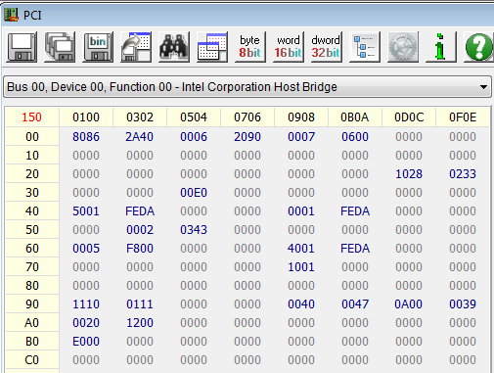
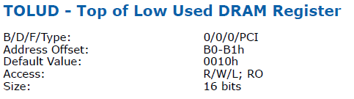
Example: Find TSEG: TOLUD
TOLUD = E000_0000h
(TOLUD – STOLEN – TSEG_SZ) to (TOLUD – STOLEN)
(E0000000 - ? - ?) to (E0000000 - ?)

Slide 29
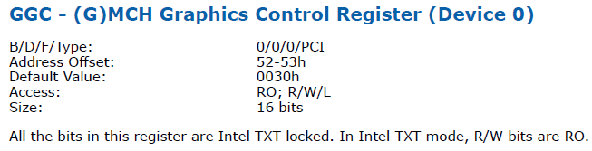
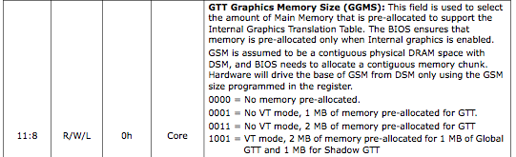
Lab: Find TSEG: STOLEN
STOLEN = 0h
Next is to find the amount of memory (if any) that has been stolen from graphics
Bits 11:8 determine the amount of graphics memory stolen
In this case it is 0
(TOLUD – STOLEN – TSEG_SZ) to (TOLUD – STOLEN)
(E0000000 - 0 - ?) to (E0000000 - 0)

Slide 30
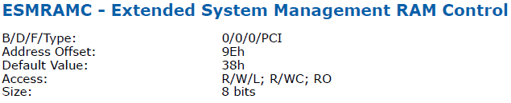
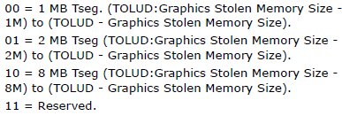
Lab: Find TSEG: TSEG_SZ
And lastly we need to determine the size of TSEG
This will differ based on architecture but for our system it’s 8 bits
(TOLUD – STOLEN – TSEG_SZ) to (TOLUD – STOLEN)
(E000_0000 - 0 - 10_0000) to (E0000000 - 0)

Slide 31
Calculate TSEG Base/Limit
E000_0000h
STOLEN
0
TSEG_SZ
1 MB
We plug our known values into:
(TOLUD – STOLEN – TSEG_SZ) to (TOLUD – STOLEN)
(E000_0000h – 0 – 1 MB) to (E000_0000 – 0)
Provides us the range:
DFF0_0000h to E000_0000h
Technically it’s DFF0_0000 to DFFF_FFFFh
This *should* be the SMBASE address (which is relocatable of course but in all likelihood will be here)
You can also read the SMRR PHYSBASE MSR if it’s supported or on a newer system read the TSEG Base/Limit from the TSEG register
SMRRs covered in a little bit

Slide 32
Calculate TSEG Base/Limit
E000_0000h
STOLEN
0
TSEG_SZ
1 MB
The TSEG base address marks the beginning of the protected SMRAM range
Therefore the TSEG base *should* equate to SMBASE
Or the lowest SMBASE value in a multi-core system, assuming shared SMRAM range
We’ll see in a bit that this isn’t necessarily the case

Slide 33
TSEG STOLEN varies
For the MCH 4, the TSEG range is defined as (TOLUD – STOLEN – TSEG_SZ) to (TOLUD – STOLEN)
But different systems will have different values, and you have to look it up in the datasheets. E.g. on a 4th gen Haswell:
(TOLUD – DSM SIZE – GSM SIZE – TSEG SIZE) to (TOLUD – DSM SIZE – GSM SIZE)

Slide 34
Homework heads up
Determine if your system’s TSEG/TOLUD are locked, or if they could be moved by an attacker
On some systems they will be locked by D_LCK, and on some TSEGMB will have its own lock bit. You need to determine which is the case for your hardware.

Slide 35
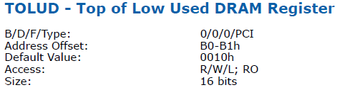
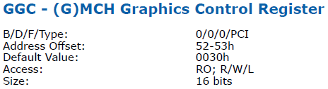

Memory Map Protection
The location of TSEG is dependent on the values of TOLUD and Stolen Memory
Modifying this value is something that an attacker could try, to shift the TSEG region
However these registers can be locked down by D_LCK bit in the SMRAM register (a key-bit)

Slide 36
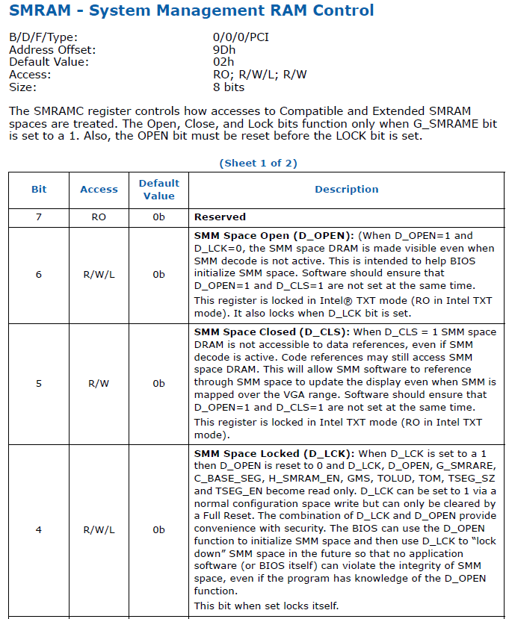
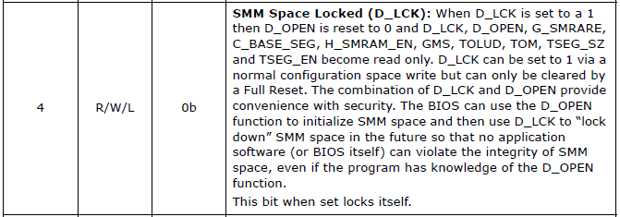
SMRAM Lock-Down
D_LCK is pretty much a necessity and is rarely left unset (5% or so of measured BIOS have D_LCK not set)
When set prevents changes to a lot of registers

Slide 37
Where can you find the all-important D_LCK bit?
MCH3 & 4 = “SMRAM” register 0/0/0/9D
2nd Gen (Sandy Bridge) CPU and newer = “SMRAMC” register 0/0/0/88

Slide 38
D_OPEN
To help the BIOS configure SMRAM, the chipset provides a means for leaving SMRAM open even when the processor is not in SMM
D_LCK prevents this bit from being asserted
Notes:
O_o

Slide 39
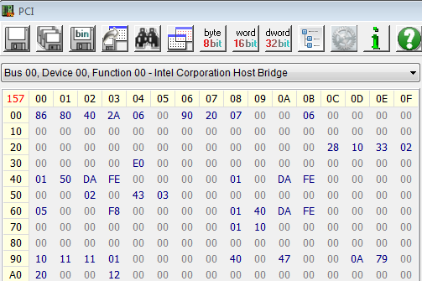
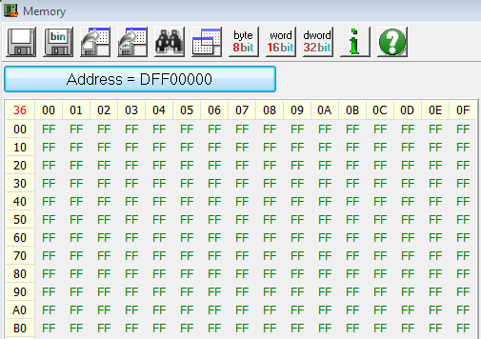
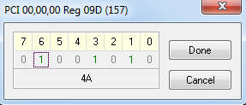
vulnBIOS specific: Viewing SMRAM
If SMRAM is properly locked down this isn’t possible
Assert the D_OPEN bit in the SMRAMC register (D0:F0, offset 9Dh)
Since it’s unlocked, let’s take a look at SMRAM
According to our TSEG calculations it should be located at DFF0_0000h
This should be SMBASE…but is it? Let’s see…

Slide 40
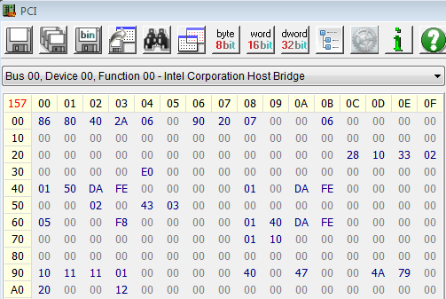
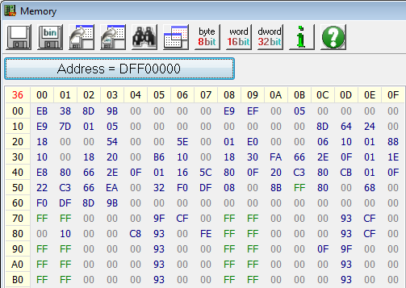
vulnBIOS specific: Viewing SMRAM
Well, there is some binary at DFF0_0000h
EB 38 is a JMP instruction which would take us to DFF0_003Ah
But shouldn’t our code enter at SMBASE + 8000h (DFF0_8000h) instead? Maybe this is just random bits.

Slide 41
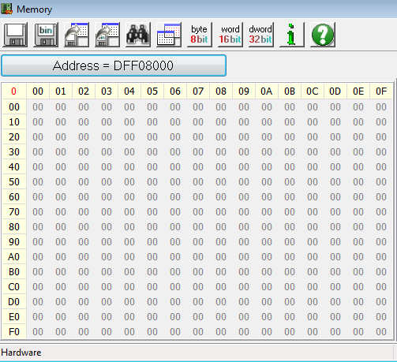
vulnBIOS specific: Viewing SMRAM
Let’s look at address DFF0_8000h
Definitely not executable code
Call it a hunch but let’s look at address DFF0_7EF8h
Recall that the SMBASE field in the state save register is located at offset SMBASE + 8000h + 7EF8h
Let’s see what that shows us

Slide 42
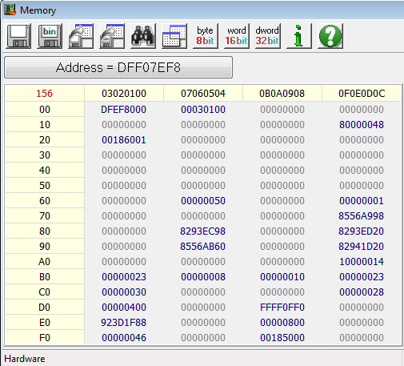
vulnBIOS specific: Viewing SMRAM
This is the SMBASE value and its value is DFEF_8000h
So SMBASE + 8000h is DFF0_0000h which is our TSEG base
Technically, the SMRAM range is outside of the TSEG protected area

Slide 43
Unprotected SMRAM Range
Protected Memory
DFF0_0000h (SMBASE + 8000h)
DFEF_8000h (SMBASE)
Unprotected Memory
We can see that it's outside the range if we go to an address just under DFF0_0000h and write some bytes
Then we can toggle the D_OPEN bit off and on and see that the bytes we just wrote are still present whether SMRAM is open or closed

Slide 44
So how bad is this?
Protected Memory
DFF0_0000h (SMBASE + 8000h)
DFEF_8000h (SMBASE)
Unprotected Memory
It’s definitely not good! But…
In *this* case the SMI handler neither references nor calls anything in this unprotected range
So it’s “okay” in this case, but could be catastrophic in another
The moral of the story: Ensure that all SMI handler accessed code/data is within the protected memory range
ITL found multiple bugs in Intel's SMM code where it was accessing data outside the protected ranges, which could consequently be attacker controlled (which led to simple "change a function pointer to jump to my code" type attacks, and could lead to buffer overflow attacks)

Slide 45
TODO
Needs a discussion of TSEG as DMA protection

